Slide 1
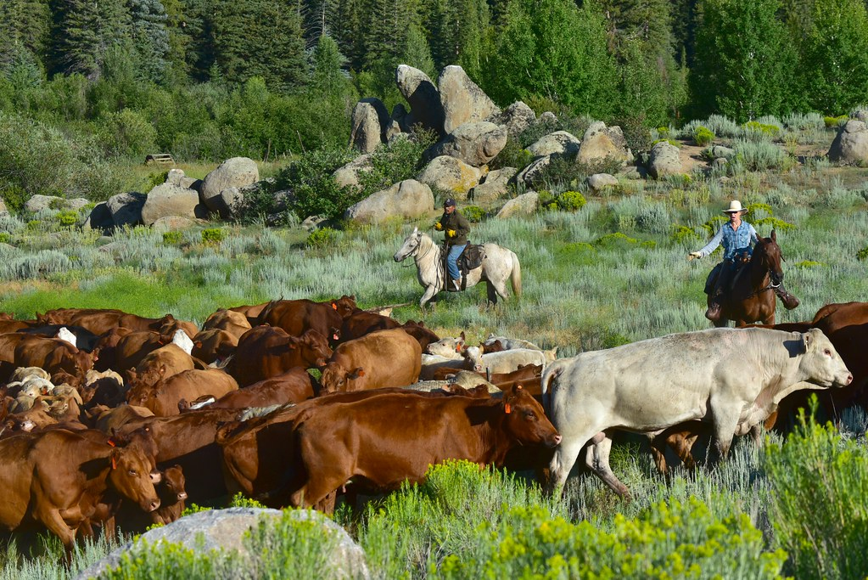
Home On The Range
This Photo by Unknown Author is licensed under CC BY

Slide 2
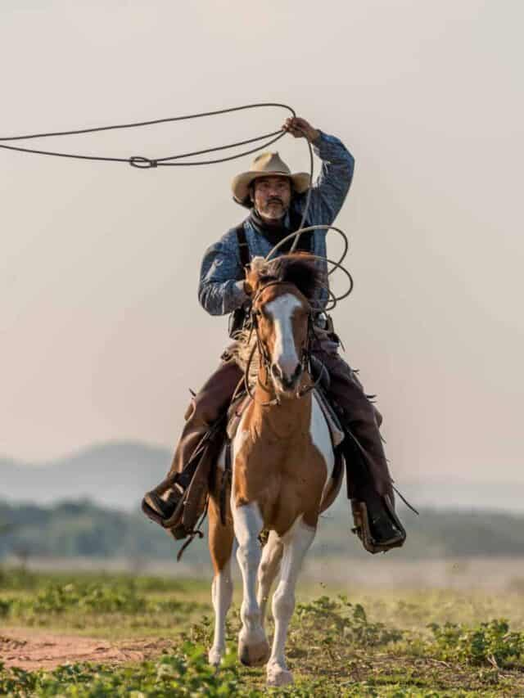
Cowboys Need Special Gear

Slide 3
What Life Was Like On The Range

Slide 5
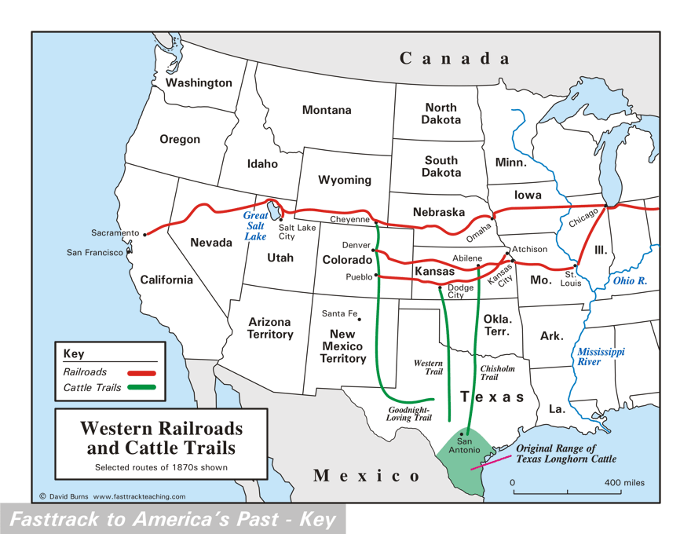

Slide 6
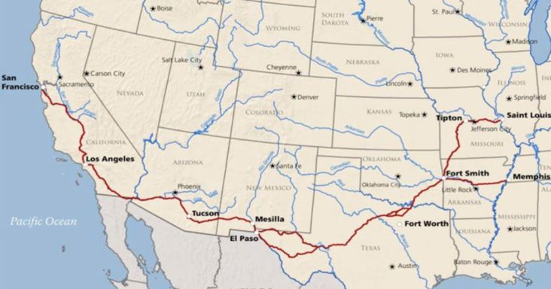
The Butterfield Overland Stage Route

Slide 7
